Slide 1


Team 6: Telescope Autofocuser
Bi-Weekly Update 1 Albin Myscich
Alonna Too-Chiobi
Camille Watson
Joseph Basdeo
Sponsor: Dr. Kevin Nowka TA: Max Lesser
Notes:
Michelle

Slide 2
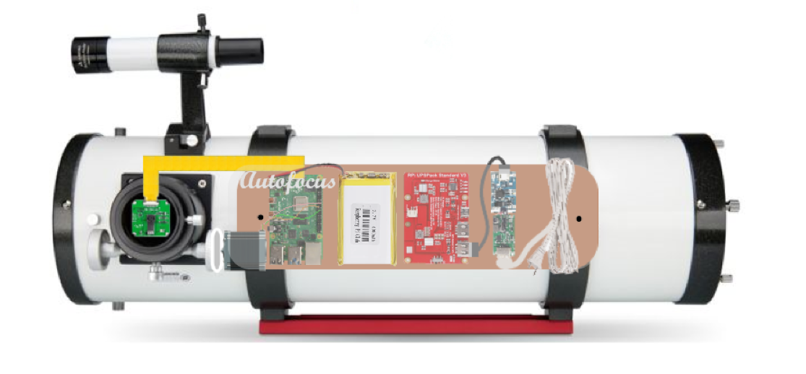
Project Summary
Telescope focusing & image processing automation
Product Will:
Stream current images to dev board using an imager
Autofocus using a stepper motor interface
Display focused image post processing through a GUI
Notes:
Kyle

Slide 3
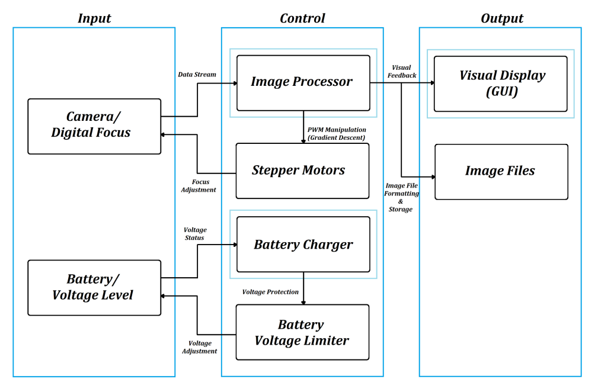
Project Design
Notes:
Here is a refresher on how the different subsystems relate to each other. Nothing has changed since our first presentation. The camera is still communicating with the image processor who is talking to the GUI, image files, and stepper motors; and the battery is still communicating with the charger who is communicating with the voltage limiter who is then talking back to the battery.

Slide 4
Project/Subsystem Overview
Owner | Subsystem | Requirements
Albin Myscich | Image Post-processing Focuser Automation | Receives real-time and post-processed images and applies an intelligent system interface capable of refining target images Receives a continuous stream of data from Imager, and adjusts the focal distance from itself and the mirrored lens via a stepper motor
Alonna Too-Chiobi | Motor Programs Motor Mounting Assembly | Adjusts focus of telescope depending on input received from image processor Adjusts position of the telescope to account for the Earth’s rotational movement Responsible for ensuring position and security of motors
Camille Watson | Power Interfacing & Redundancy | Provides the Raspberry Pi board, motors, and imager with sufficient power to smoothly perform their functions
Joseph Basdeo | Imager Imager Mounting Assembly Graphical User Interface (GUI) | Capture images through telescope focuser Display Image using a GUI Responsible for position and security of camera
Notes:
Task partitions have remained the same

Slide 5
Motor Assembly
Alonna Too-Chiobi
Accomplishments since 403 3.75 hrs of effort | Ongoing progress/problems and plans until the next presentation
Tested and verified that code still executes as designed and motor still operates as expected | Introduce a “dampening” attribute to motor code to improve motor precision Introduce an equatorial mount to compensate for the Earth’s rotation

Slide 6
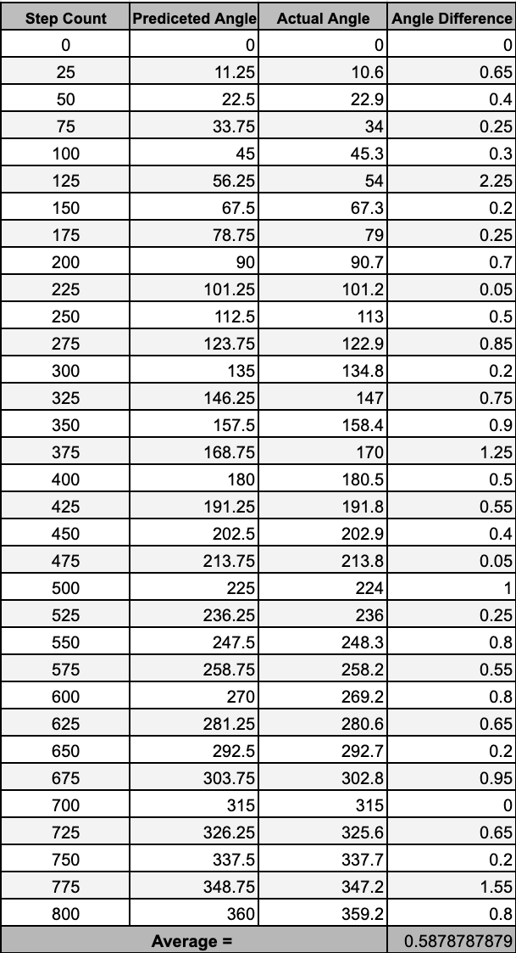
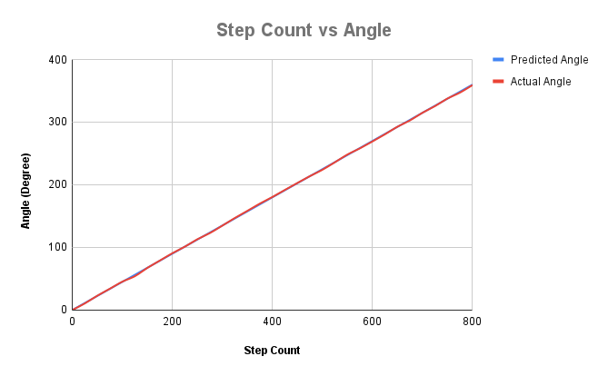
Motor Assembly
Alonna Too-Chiobi
Notes:
Show the error and display difference in angle and show how good they arre meergingn
standard deviation
explain testing methods and why does it makes sense
Albin may have to come up with a metric (look up denoising methods)

Slide 7
Imager and Mounting Assembly
Joseph Basdeo
Accomplishments since 403 8 hrs of effort | Ongoing progress/problems and plans until the next presentation
Redesigned and printed new camera mount Tested and verified camera captures and saves images to Raspberry Pi | Design and build dev board mount Calibrate and test telescope collimation Integrate imager with motor assembly

Slide 8
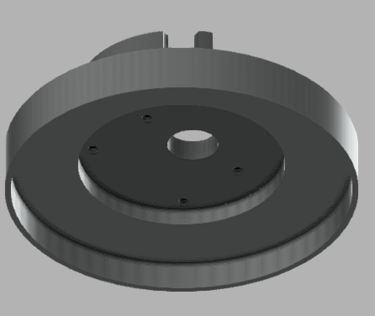
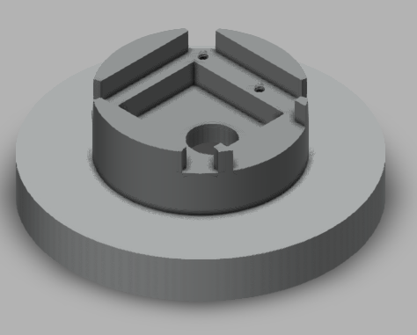
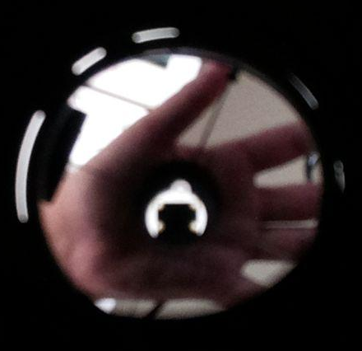
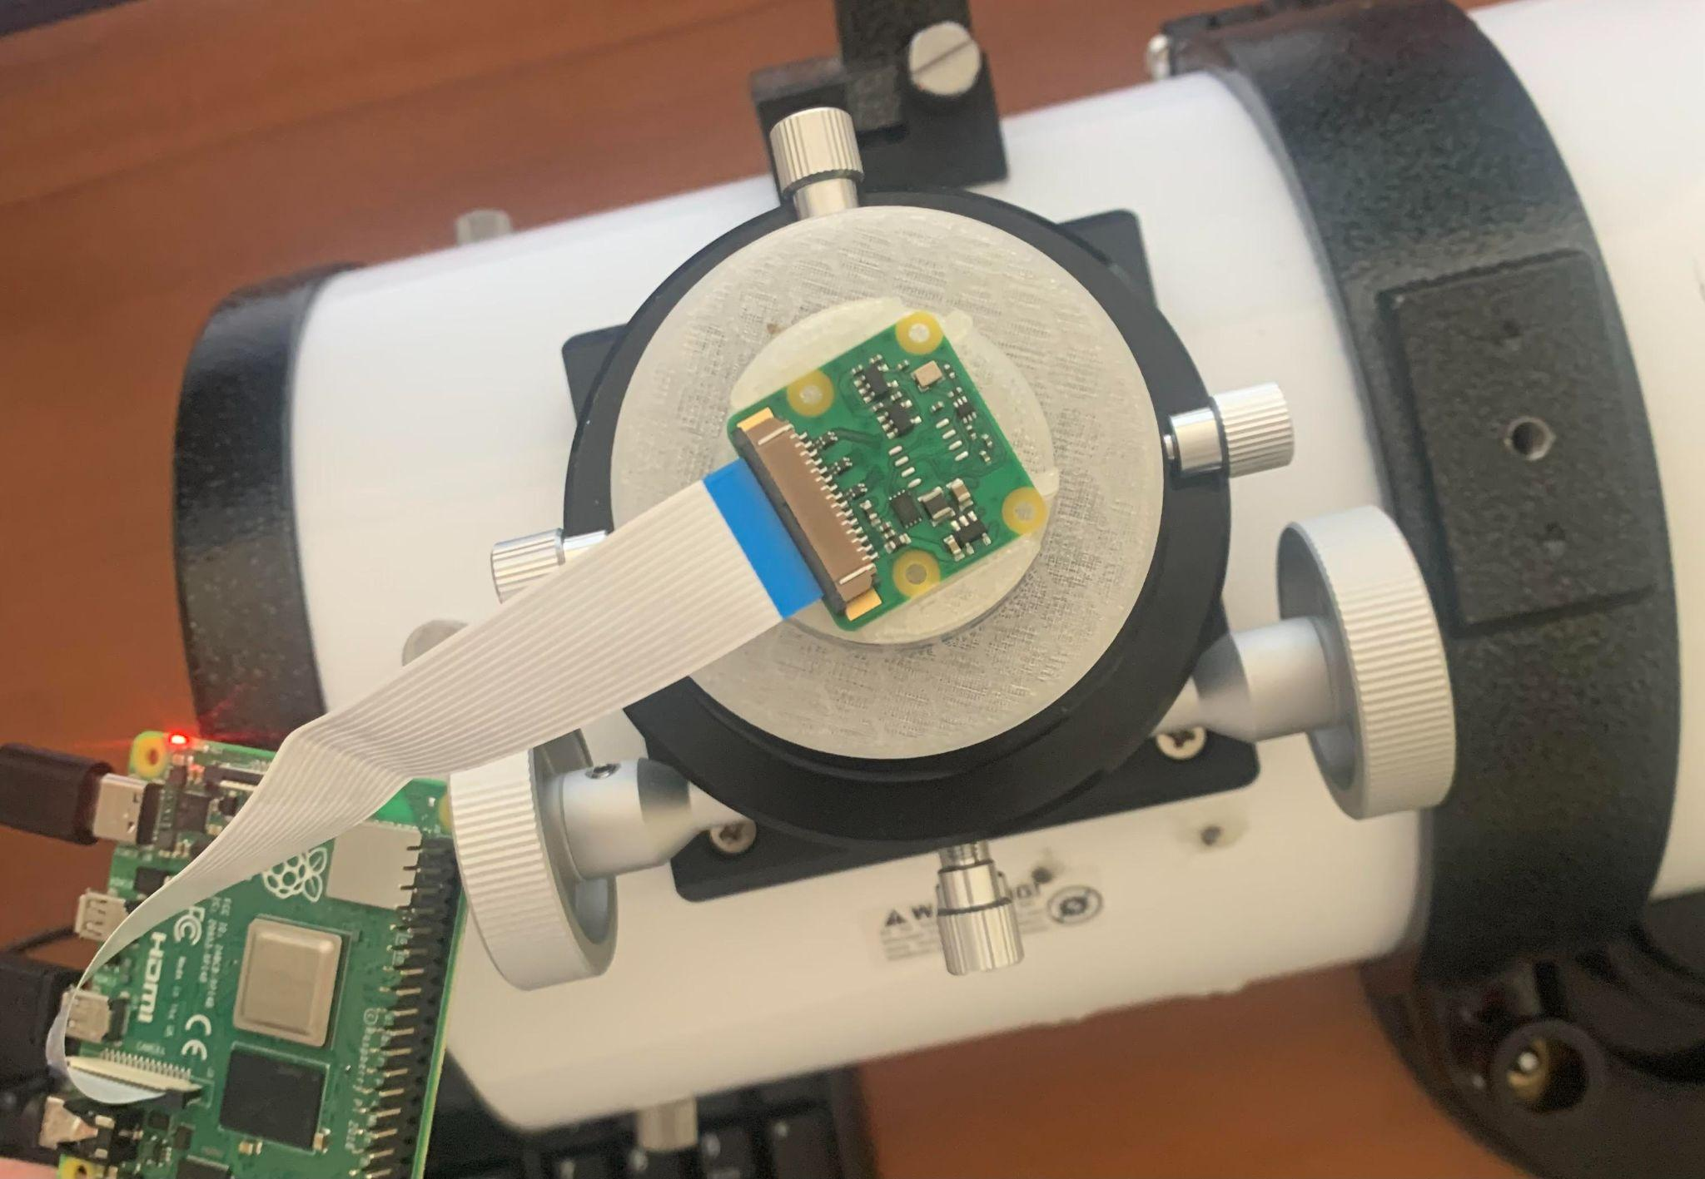
Imager and Mounting Assembly
Joseph Basdeo
Sample Image
Imager Mount Design & Implementation

Slide 9
Power Supply
Camille Watson
Accomplishments since 403 23 hrs of effort | Ongoing progress/problems and plans until the next presentation
Re-validated working circuit from last semester Completed Altium Designer tutorials Converted circuit to Altium Designer | Validate PCB and generate files Ensure PCB will be properly soldered by practicing on kit

Slide 10
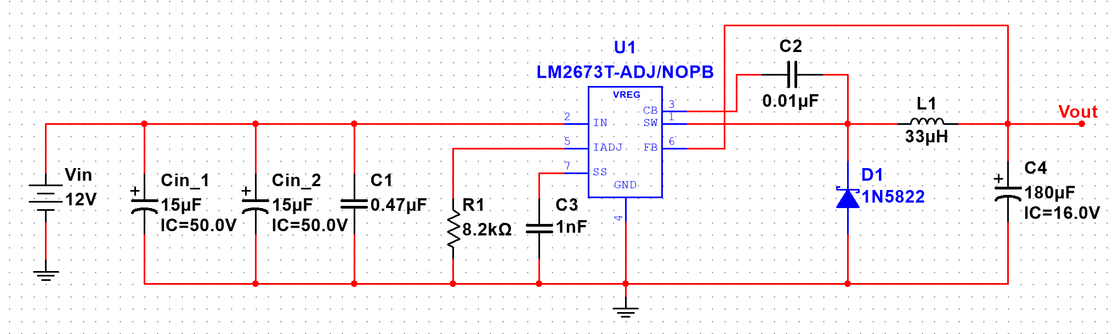
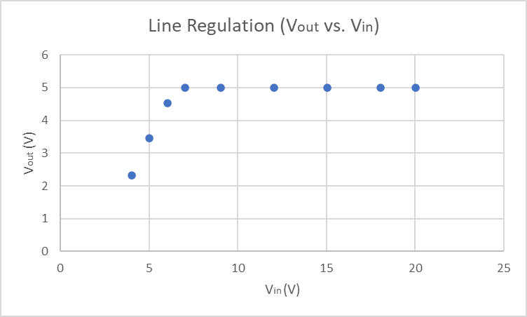
Power Supply
Camille Watson
Note: add line at 9V
Multisim Simulation of Buck Converter
Line Regulation of Buck Converter

Slide 11
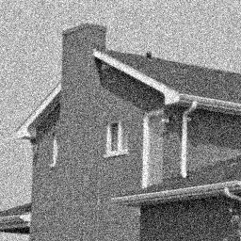
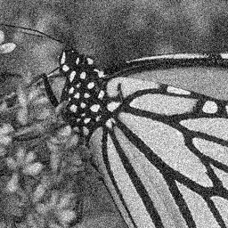
Image Processing & Autofocusing Program
Albin Myscich

Slide 12
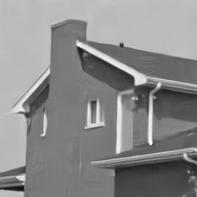
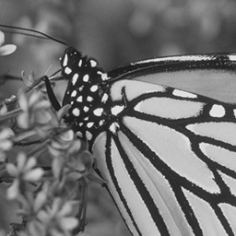


Image Processing & Autofocusing Program
Albin Myscich
Gaussian Denoising: DnCNN
https://github.com/cszn/DnCNN
Notes:
https://github.com/cszn/DnCNN

Slide 13
Image Processing & Autofocusing Program
Albin Myscich
Gaussian Denoising: DnCNN
Denoised
Ground Truth
https://github.com/cszn/DnCNN
Notes:
https://github.com/cszn/DnCNN

Slide 14
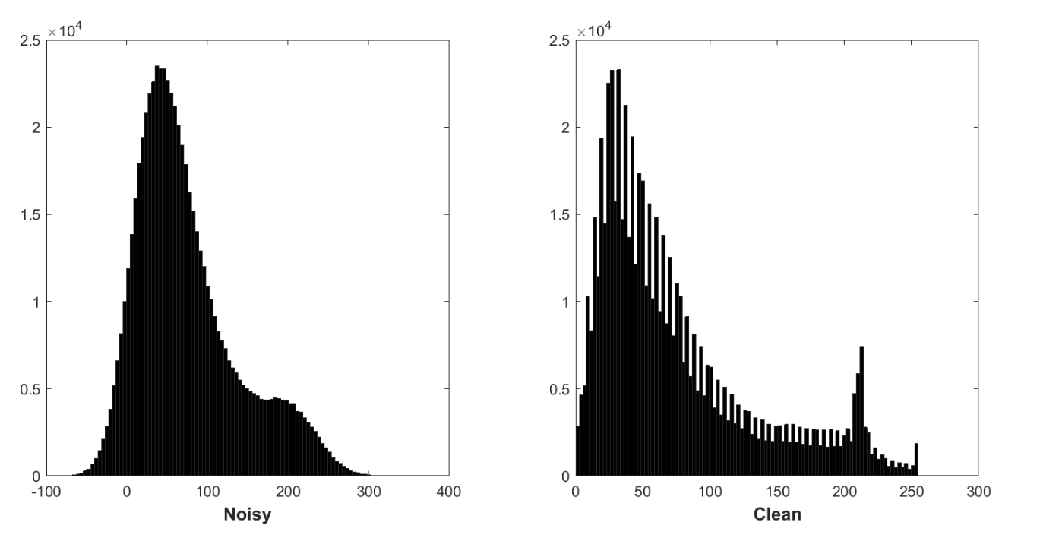
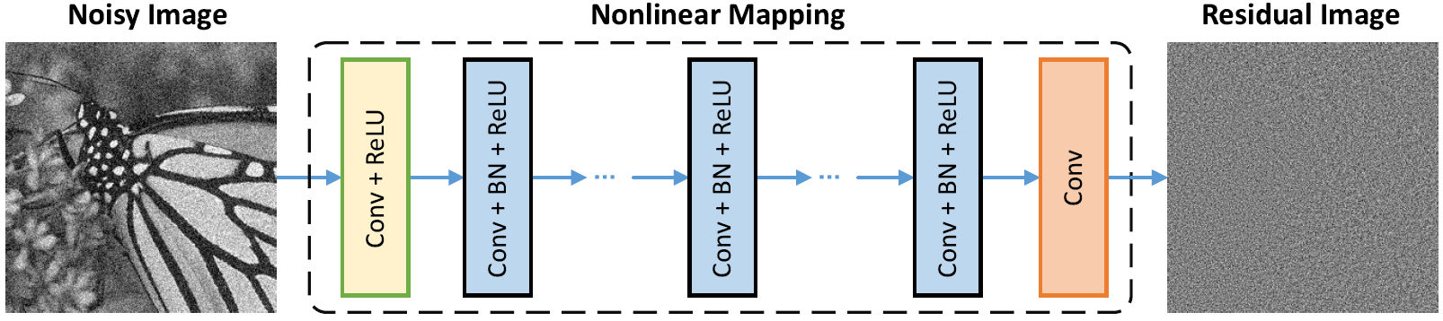
Image Processing & Autofocusing Program
Albin Myscich
Noisy image residual corrupted by AWGN
Follows a constant Gaussian distribution
Stabilizes batch normalization during training
Predicting the residual
Performing one gradient descent stepping]
Noise Level of 50 PSNR (db)
Approximately 26.23
https://github.com/cszn/DnCNN
Notes:
AWGN - Additive White Gaussian Noise
PSNR - peak signal-to-noise ratio

Slide 15
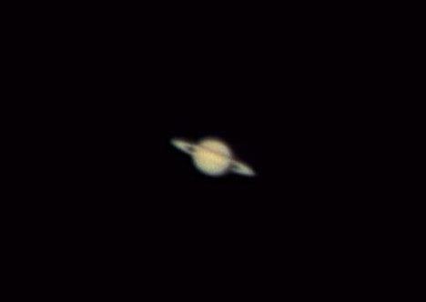

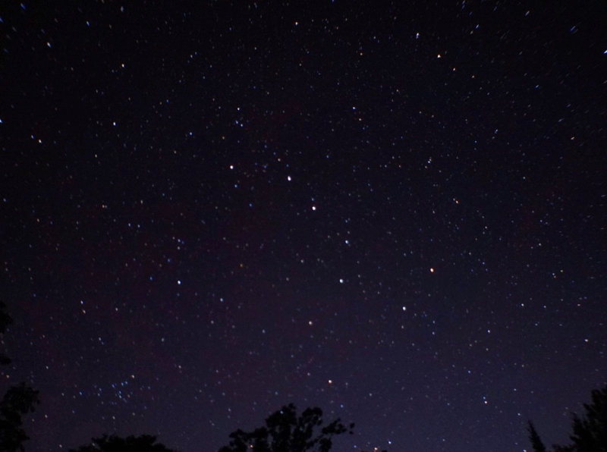

Image Processing & Autofocusing Program
Albin Myscich
Denoised+Opt
Ground Truth

Slide 16
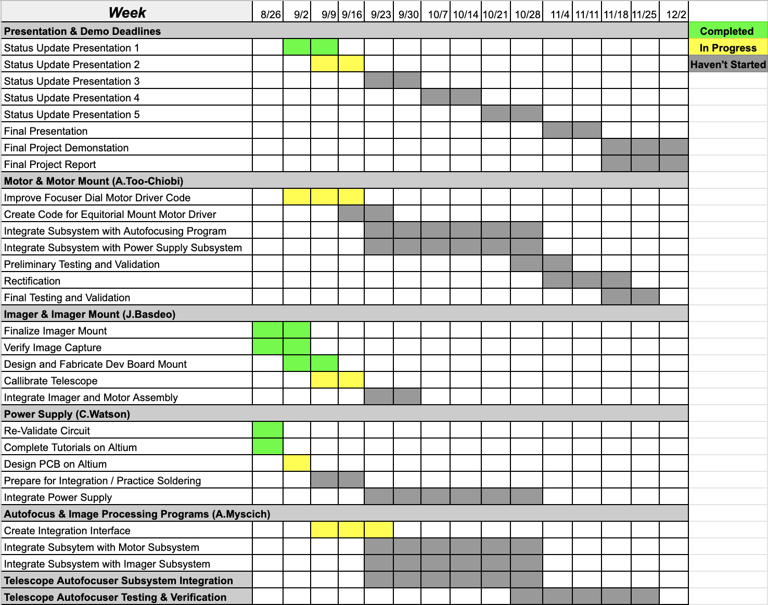
Execution & Plan
Notes:
Michelle

Slide 17
Q/A

